Slide 1



VK26-IITI-AHM-0295

Slide 2
Project Overview
Title - ‘SwasthEdge’
Team ID - VK26-IITI-AHM-0295
Track - Theme: Al in Hardware Manufacturing
Sub-Theme: Edge Al & On-Chip Processing
“A low-cost self-diagnosing edge controller that fuses sensor, electrical, and controller-health data to confirm faults locally and trigger appropriate responses without continuous cloud connectivity.”

Slide 3
Problem Statement
Operational Pain Point -
          Low-cost edge controllers in industrial and remote environments can face sensor drift, disconnection, abnormal power consumption, and supply instability, creating a need for an embedded system that can monitor device and sensor health, distinguish persistent faults from temporary abnormalities, and provide an appropriate local response.
Target Beneficiary Segment -
Small and medium-scale industries, manufacturing systems, smart agriculture, environmental monitoring, remote infrastructure, and Industrial IoT/edge deployments where continuous network connectivity or manual monitoring may not always be available.

Slide 4
User Journey – Before State
Flowchart
Operational Impact
Incorrect operation
Equipment damage
Unplanned downtime
Maintenance risk
Existing Edge System
Sensor / Device Abnormality Occurs
Abnormality Is Difficult to Interpret
Fault May Remain Undetected
BASELINE INEFFICIENCY — TO BE ESTABLISHED
Fault-Detection Latency | False-Alarm Behaviour | Processing Overhead | Operational Impact
Time taken to recognize an injected fault | Incorrect responses to temporary abnormalities | CPU / RAM / processing cost | Effect of undetected or delayed faults
Baseline values will be established through controlled fault-injection tests before SwasthEdge evaluation.

Slide 5
User Journey – After State
Flowchart
Continuous Health Monitoring
Fault Detection & Analysis
Health Fusion & Fault Confidence
Local State Decision
SwasthEdge Retrofit
Operational Benefit
Safer operation
Reduced Maintenance risk
Reduced downtime
Early fault awareness
Local Diagnostic Logging
Appropriate Local Response
EFFICIENCY METRICS — TO BE BENCHMARKED
Fault-Detection Latency | Fault-Confirmation | Processing & Power Overhead | Local Response & Continuity
Time from fault injection to local detection | Ability to distinguish persistent faults from temporary abnormalities | CPU / RAM / processing latency / additional power | Response state and diagnostic retention during network loss
SwasthEdge performance will be compared with sensor-only detection using controlled fault-injection tests.
From reactive detection to locally confirmed, self-diagnosing operation

Slide 6
System Block Diagram
SENSOR HEALTH
SHT31 • Temperature / humidity
EWMA / CUSUM • Range • Drift
ELECTRICAL HEALTH
INA226 • Voltage / Current / Power
Shunt resistor • Voltage divider
CONTROLLER HEALTH
MCU temperature • Resets
Watchdog status • Communication errors
FAULT INJECTION RIG
Digital potentiometer • MOSFETs / relays
Sensor & electrical fault simulation
STM32F446RE MICROCONTROLLER
POWER MANAGEMENT
12V input → LM2596 buck (12V → 5V) → AMS1117 LDO (5V → 3.3V)
Powers MCU, sensors, ccommunication and peripherals
FEATURE EXTRACTION
Mean • Variance • Slope • RMS • EWMA • CUSUM • Cross-correlation
EXTERNAL HARDWARE WATCHDOG
TPS3813K33
Independent hardware reset if firmware hangs
Connection: NRST
TINYML INFERENCE
Autoencoder + Random Forest • int8 quantization • TensorFlow Lite Micro
HEALTH FUSION
Multi-parameter weighted fusion • Confidence score (0–100%)
STATE MACHINE
Normal → Warning → Degraded → Critical
DISPLAY
OLED • Status LEDs
Normal / Warning / Fault
LOCAL RESPONSE
Relay trip • Fault isolation
Safe fallback mode
DATA LOGGING
MicroSD • W25Q64 SPI Flash
RTC timestamps • Event / fault logs
COMMUNICATION
MAX13487EESA • RS485 / Modbus RTU
Fleet aggregation (target up to 1200 m)

Slide 7
Target Specifications & Hardware Selection
Parameter | Target Specification | Rationale
Inference Latency | < 100 ms | Ensures real-time detection before critical damage.
Flash Budget | < 80 KB (of 512 KB) | Proves viability on a cost-sensitive, resource-aware MCU.
RAM Budget | < 32 KB (of 128 KB) | Leaves headroom for other application tasks.
Current Draw | < 20 mW incremental | Maintains energy efficiency for remote edge deployments.
Fault States | 4-State Model | Enables graceful degradation (Normal → Critical).
Comms Range | Up to 1200m | Ensures fleet aggregation in large factories without Wi-Fi.
Subsystem | Selected Hardware | Interface / Protocol
Core Controller | STM32F446RE (Arm Cortex-M4, 180 MHz) | —
Sensor Health | SHT31-DIS (Temperature & Humidity) | I2C (400 kHz)
Electrical Health | INA226 (Voltage, Current, Power) | I2C (400 kHz)
Fleet Comms | MAX13487EESA (Isolated RS485) | Modbus RTU (UART)
Local Logging | W25Q64 SPI Flash & MicroSD Card | SPI
Safety / Watchdog | TPS3813K33 (External Hardware Watchdog) | GPIO / NRST
Actuation | 5V SPDT Relay & ULN2003 Driver | GPIO
Power Management | LM2596 (Buck) & AMS1117 (LDO) | 12V → 5V → 3.3V
Architecture Rationale:-
STM32F446RE DSP support enables on-device TinyML without an external NPU. I²C reduces sensor pin count; isolated RS485 supports long-distance communication in electrically noisy environments. The TPS3813 watchdog remains independent of firmware to recover from lockups.

Slide 8
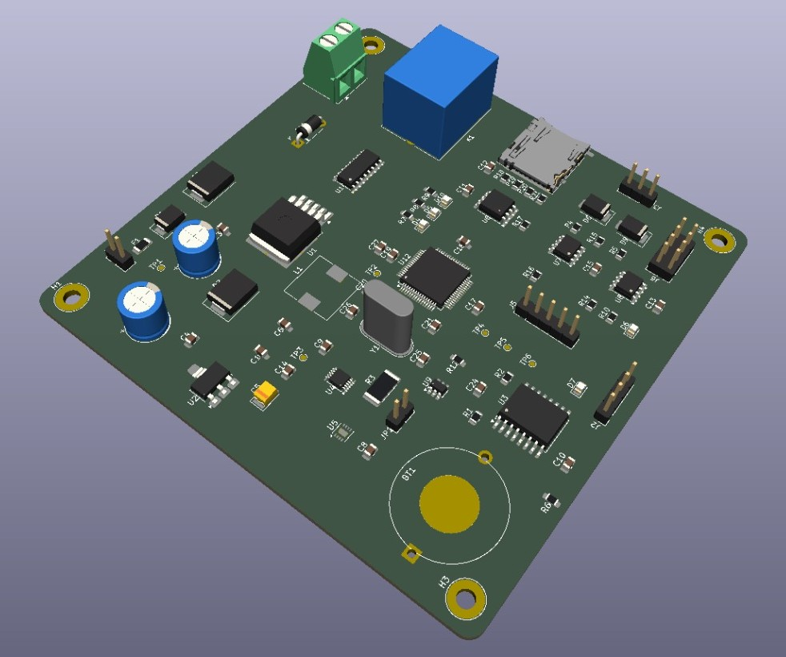
PCB
Physical Specifications
3D Design View
120 × 100
mm board footprint
2-layer
FR-4 PCB
1.6 mm
board thickness
FUNCTIONAL ZONES REPRESENTED IN THE LAYOUT
Functional Zone | Description
CORE COMPUTE | STM32F446RE MCU and 8 MHz crystal clock.
SENSING & COMMS | I²C sensor path plus isolated RS485 fleet interface.
RESILIENCE | External watchdog, protection devices and fault-injection circuitry.
DATA & POWER | W25Q64 SPI flash, microSD interface, LM2596 buck and AMS1117 LDO.
DESIGN INTENT
A compact, low-cost board integrates monitoring, communications and deliberate fault stimulus on one controller platform.
Figure: Custom 120x100mm 2-layer PCB integrating sensing, communication, and fault-injection circuitry for cost-sensitive viability.
03 / 06

Slide 9
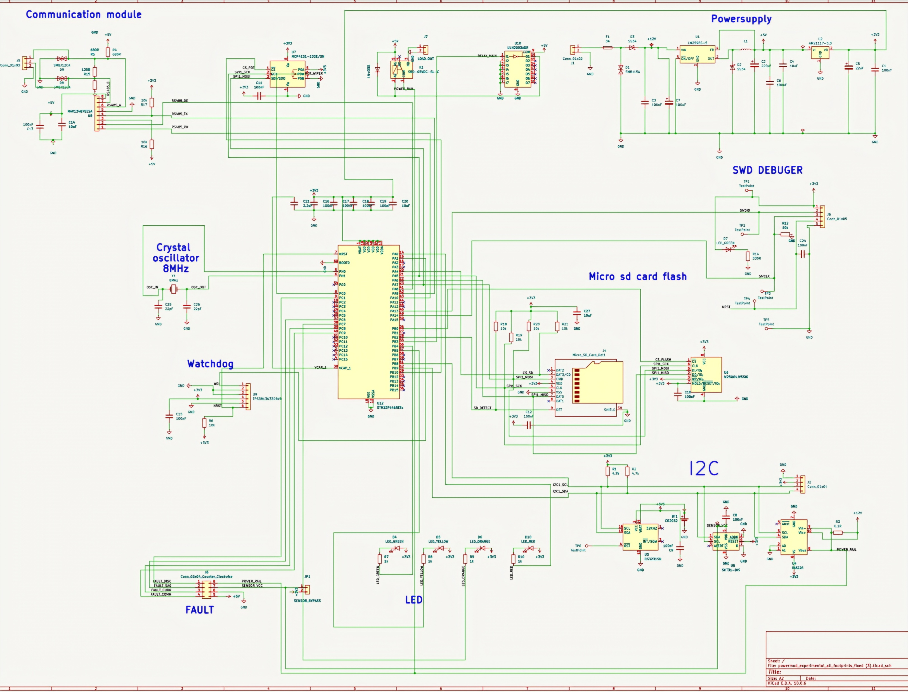
Electronics Schematic & PCB Integration
KiCAD Schematic
SCHEMATIC SUBSYSTEM MAP
Subsystem | Description
MCU + CLOCK | STM32F446RE with 8 MHz crystal and debug header.
SENSORS + I²C | SHT31-DIS and INA226 share the internal sensor bus.
FLEET COMMUNICATION | MAX13487EESA isolated RS485 interface for Modbus RTU.
LOCAL DATA | W25Q64 SPI flash and microSD card interface.
SAFETY + FAULTS | TPS3813 watchdog, reset path, protection and fault-injection header.
POWER RAILS | 12 V input conversion to 5 V and 3.3 V rails.
Drop cropped KiCad schematic here
STM32F446RE
(Edge AI Core)
Integrated Fault
Injection
RS485 Fleet
Aggregation
Design Rationale:-
The schematic integrates independent health-monitoring mechanisms (I2C sensors, RS485, Watchdog) around a single low-cost STM32F446RE MCU. The dedicated fault-injection module allows us to physically induce and test faults on the running device, proving the system's autonomous response.
Figure: supplied KiCad schematic • communication, power, I²C, storage, watchdog and fault blocks

Slide 10
Bill of Materials
Component | Part / Specification | Quantity | Lead Time | Estimated Cost (INR)
Core Controller | STM32F446RET6 (Arm Cortex-M4, 180MHz) | 1 | Local (3 days) | ₹550
Health Sensors | SHT31-DIS (Temp/Humidity) & INA226 (Power) | 1 Set | Domestic (7 days) | ₹700
Comms & RTC | MAX13487EESA (RS485) & DS3231SN (RTC) | 1 Set | Domestic (5 days) | ₹380
Data Logging | W25Q64 (8MB SPI Flash) & MicroSD Slot | 1 Set | Local (2 days) | ₹130
Power & Relay | LM2596, AMS1117, 5V Relay, ULN2003 | 1 Set | Local (2 days) | ₹250
Fault Injection | TPS3813 Watchdog, MOSFETs, TVS Diodes | 1 Set | Domestic (5 days) | ₹350
Passives | 8MHz Crystal, Capacitors, Resistors, LEDs | 1 Set | Local (2 days) | ₹250
Custom PCB | FR4 2-Layer 1.6mm (120x100 mm) | 5 | Domestic (6 days) | ₹1,500
COST-SENSITIVE VIABILITY
PROCUREMENT STATUS
Core parts are listed as locally or domestically sourced within India; the maximum stated shipping lead time is 7 business days.
Under the ₹4,200 target in the supplied project narrative, keeping electronics costs accessible for MSME retrofits.
05 / 06

Slide 11
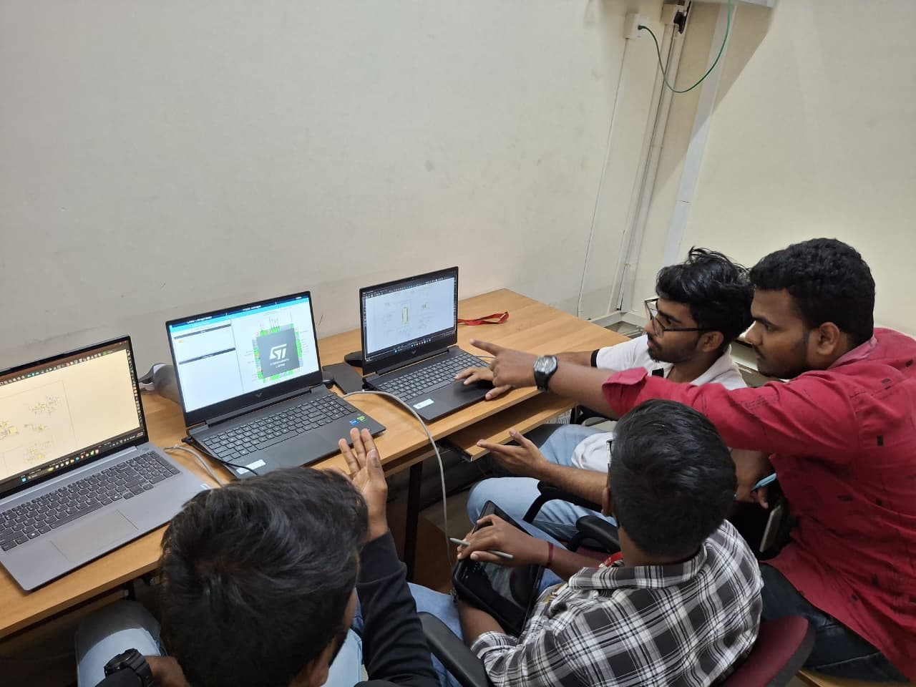
Maker Journey
Stage 1 to Stage 2 Engineering Progress & Evidence
SYSTEM & FIRMWARE
STM32F446RE-based edge controller; firmware assets organized in the repository.
ELECTRONICS DESIGN
KiCad schematic, PCB layout and bill of materials are grouped under /hardware.
TINYML WORKFLOW
ML data, notebooks and model assets are organized under /ml.
DOCUMENTATION & DEMO
Architecture, validation documents, presentation material and demo-video links are grouped in the repository.
Figure: Team reviewing electronic design and development work together

Slide 12
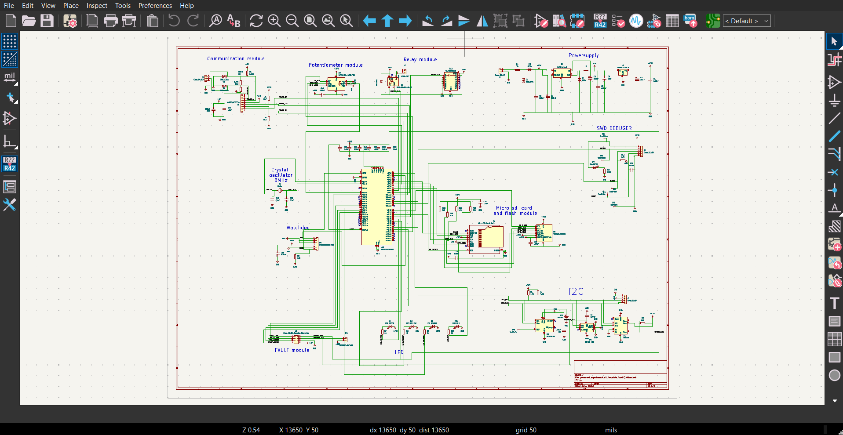
Work-In-Progress Software Evidence
Figure - EDA layout software (KiCad)
github.com/ConquerToFreedom/SwasthEdge
RAW REPOSITORY LINK
Firmware • Hardware • ML • Documentation • Presentation • Demo resources

Slide 13


Safety & Hazard Mitigation
Standards / Compliance
Fault Confirmation:
Use sensor readings together with voltage, current and MCU-health indicators before increasing fault confidence.
Graceful Degradation:
Normal → Warning → Degraded → Critical operating states prevent unnecessary escalation.
Local Fail-Critical Response:
Warning, faulty-sensor isolation, fallback values, reduced operation, communication recovery, or predefined critical state.
Fault Monitoring:
Monitor sensor drift, power abnormalities, controller health and communication failures continuously.
Functional Safety —
IEC 61508
Reference for safety-related electrical/electronic/programmable functions and their safety lifecycle.
Industrial EMC —
IEC 61000-6-2 / IEC 61000-6-4
Reference for industrial-environment immunity and emissions of electrical/electronic equipment.
Industrial Cybersecurity —
IEC 62443-4-1 / IEC 62443-4-2
Reference for secure product development and technical security requirements for industrial automation/control-system components.
Standards are considered as design and validation references; no formal compliance or certification is claimed at the prototype stage.

Slide 14
Roadmap
Fabrication Phase (Months 1 - 2)
Integration & Field Demo (Months 3 - 4)
October 2026 — System Setup & Breadboard Prototype
Finalize MCU, sensor and power-monitoring architecture
Establish normal sensor/controller behaviour
Build breadboard-based functional prototype
Integrate voltage/current and sensor monitoring
Prepare controlled fault-injection setup
November 2026 — Self-Diagnosis Firmware
Implement sensor-drift detection using EWMA/CUSUM
Implement MCU health and communication monitoring
Integrate local diagnostic logging
Evaluate lightweight TinyML-based anomaly detection
Prepare firmware for PCB migration
December 2026 — PCB & Health-Fusion Integration
Finalize schematic and PCB layout
Develop health-fusion and fault-confidence logic
Implement Normal → Warning → Degraded → Critical states
Integrate local fault responses and fallback handling
Assemble and bench-test PCB prototype
January 2027 — Validation & Stage 3 Readiness
Conduct controlled fault-injection tests
Compare sensor-only vs. multi-parameter health fusion
Measure detection performance, false alarms, latency, CPU/RAM and power overhead
Validate PCB prototype and Stage 3 field-testing readiness
Stage 3 Target: Working SwasthEdge prototype validated through controlled fault injection and ready for functional field testing.

Slide 15
Technical Challenges & Risks
Engineering Challenge / Risk | Potential Impact
Distinguishing Drift from Normal Variation | Temporary fluctuations may be misclassified as persistent sensor faults, causing false alarms.
Multi-Parameter Health Fusion | Combining sensor, power, and MCU-health indicators while maintaining reliable fault confidence can increase algorithm complexity.
Limited MCU Resources | EWMA/CUSUM, health-fusion logic, logging and continuous monitoring must remain within available CPU, RAM, flash and power budgets.
Abnormal Power / Supply Conditions | Voltage or current disturbances may affect both the monitored sensor and controller, making fault attribution difficult.
Communication Loss | Network failure can interrupt remote monitoring and requires reliable local diagnostic logging and recovery logic.
Graceful Degradation Decisions | Selecting the correct transition between Normal → Warning → Degraded → Critical without unnecessary shutdown is a key control challenge.
Key Engineering Constraint: Achieve reliable local self-diagnosis while keeping computation, memory, latency and additional power consumption suitable for a low-cost MCU.

Slide 16
Potential Solutions & Risk Mitigation
Potential Risk / Failure | Potential Solution / Mitigation
Sensor Drift | Detect gradual deviation using EWMA/CUSUM and validate against other health indicators.
Sensor Disconnection / Failure | Identify abnormal readings or loss of data, isolate the faulty sensor, and use a fallback value where applicable.
Power Instability / Abnormal Current | Continuously monitor voltage and current and raise fault confidence when electrical behaviour becomes abnormal.
MCU / Controller Fault | Monitor temperature, reset cause, watchdog, communication and memory health; move to a predefined safe state when required.
Communication Failure / Network Loss | Attempt communication recovery and use local diagnostic logging so fault information is retained without network connectivity.
Persistent vs. Temporary Abnormality | Use health fusion + fault-confidence rather than relying on a single threshold.
Escalating Fault / Unsafe Operation | Apply graceful degradation: Normal → Warning → Degraded → Critical.
Fallback strategy: When the primary signal or subsystem becomes unreliable, SwasthEdge progressively reduces risk through validation, isolation, fallback operation, recovery attempts, and safe-state transition.

Slide 17
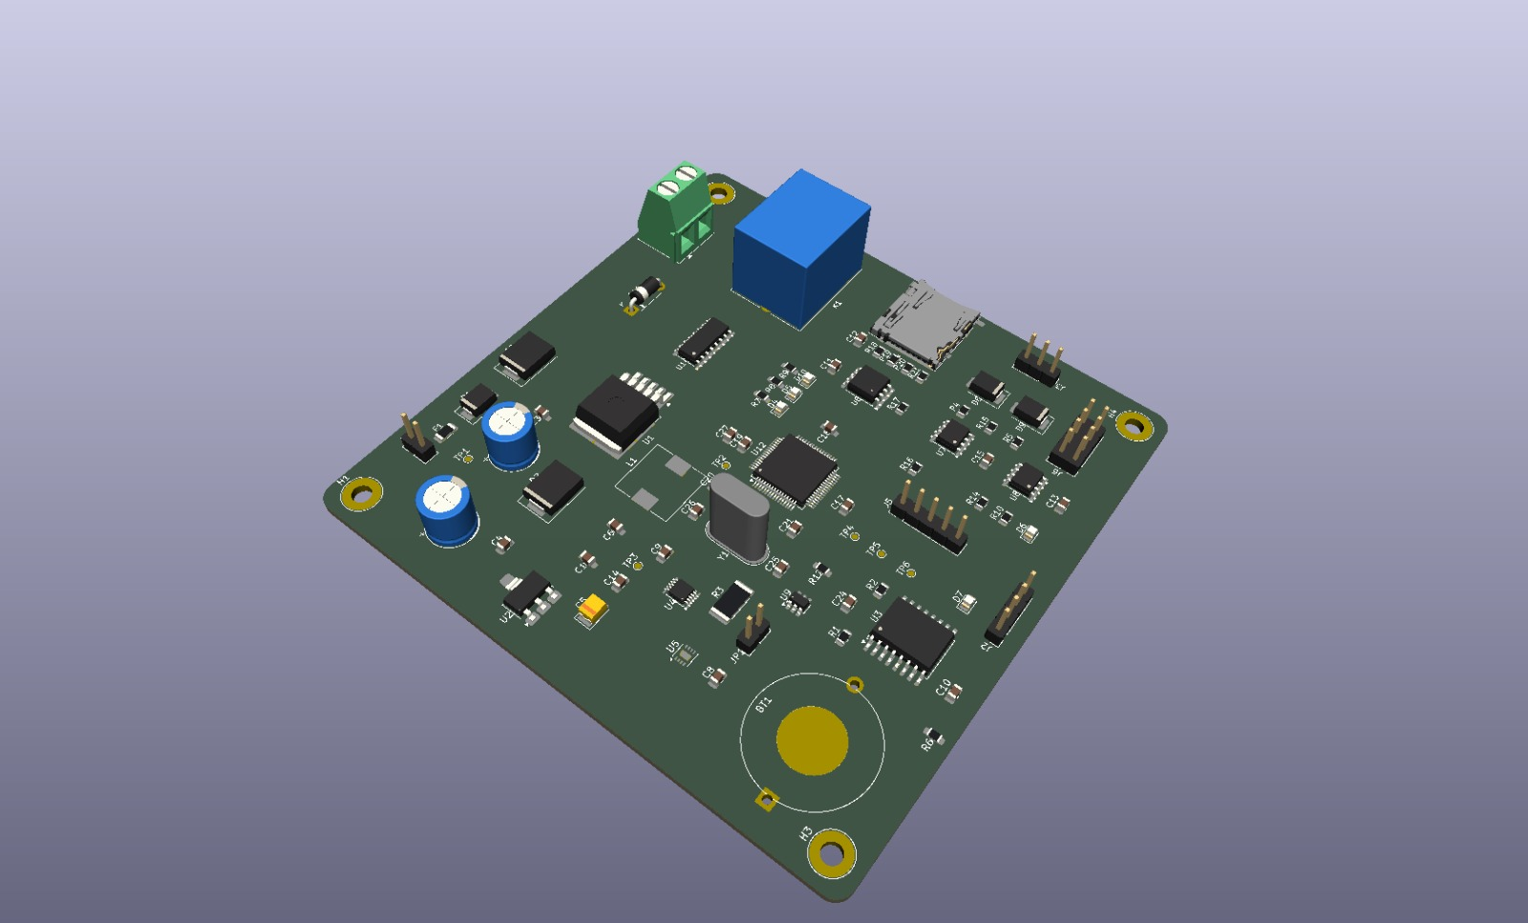
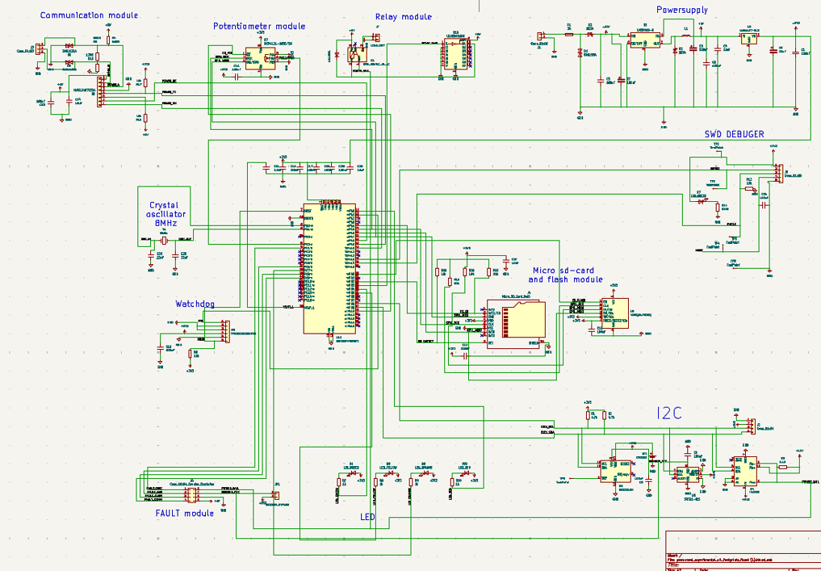

References & Sources
https://drive.google.com/file/d/1dnByVkEYSe0oNmhWJHl_LqgME7DfzbQf/view?usp=sharing
Source: kicad.org
https://drive.google.com/file/d/1kDl99OrYiaQH-MKtF4ZofFpnlcUhNGUL/view?usp=sharing
Source: kicad.org
https://drive.google.com/file/d/1J8Kl_8mwQmn7bzhAZe8TgKNee2rkjtv4/view?usp=sharing
Source: kicad.org

Slide 18
Image Sources
https://drive.google.com/file/d/1AR_u_w9m7Jpl2TkPtHfas62wOEYsVLAI/view?usp=sharing
Source: drive.google.com

